Slide 1
Predicting stock price by creating a Machine Learning Model
By: 1RV19CS071 Rishabh Khetan
1RV19CS089 Mohamed Moin Irfan

Slide 2
Problem Statement
With the innovation in technology and their application in the stock market, the system has become increasingly complex and volatile which in turn has made human predictions highly inaccurate, but using Machine Learning to find out the patterns in the system using historical data can help us predict the future prices more accurately.

Slide 3
Objectives
We want to maximize our true positives - days when the algorithm predicts that the price will go up, and it actually goes up.
Therefore, we'll be using precision as our error metric for our algorithm.
This will ensure that we minimize how much money we lose with false positives (days when we buy the stock, but the price actually goes down).
This means that we will have to accept a lot of false negatives - days when we predict that the price will go down, but it actually goes up. This is okay, since we'd rather minimize our potential losses than maximize our potential gains.

Slide 4
Proposed System
The financial market is a dynamic and composite system where people can buy and sell currencies, stocks, equities and derivatives over virtual platforms supported by brokers.
Stock markets are affected by many factors causing the uncertainty and high volatility in the market. Although humans can take orders and submit them to the market, automated trading systems (ATS) that are operated by the implementation of computer programs can perform better and with higher momentum in submitting orders than any human.
Since most of the dealings in the markets are done by automated systems, it has now been well established that training the past data can help us in finding patterns in the movement of the markets which can be used to predict the future prices.
If implemented successfully with a higher accuracy than existing systems, it could turn into a financial support system with minimal amount of risk.
We will be using a Random Forest Classification algorithm as the dataset that we train is completely discrete and we will be using several indicators to calculate the data on which the training will be performed.

Slide 5
Tools
IEEE, Arxiv.org, google scholar
These tools are used to retrieve the required research papers for the sake of literature survey. The google scholar is a very good tool since it automatically sends the required research papers, as and when someone publishes new paper.
IDE
Google COLAB/Jupyter Notebook, these ide’s are used to implement the python code and are helpful to implement different libraries such as numpy, pandas, scikit learn and matplotlib.
LANGUAGES
Python - It is used to implement the machine learning model and also it contains rich source of libraries like numpy, pandas and scikit learn

Slide 6
Data set and methodology:
The dataset will be imported through kaggle easily. For training the model we would just need prices of the required stocks over certain periods of time. We are using the stocks data of five different companies from different fields( JP MORGAN, IBM, COSTCO, ARROWHEAD PHARMACEUTICALS and HOME DEPOT). The parameters that the data will be trained on are OHLC ( open, high, low, close) and some additional parameters(indicators) to achieve even higher accuracy that will comprise the innovative component of the proposed system.
We will be using a Random Forest Classification algorithm as the dataset that we train is completely discrete and we will be using several indicators to calculate the data on which the training will be performed.

Slide 7
Dataset Details
The dataset will be imported through Yahoo Finance easily by using python libraries.
For training the model we would just need prices of the required stocks over certain periods of time.
The parameters that the data will be trained on are OHLC ( open, high, low, close) and some additional parameters(indicators) to achieve even higher accuracy that will comprise the innovative component of the proposed system.

Slide 8
Literature Survey
Year, Name of the Journal, Conference | Title of The Paper | Authors of the Paper | Description of the Paper | Limitations of the Paper/ Future Work
2022 International Conference on Advances in Computing, Communication and Applied Informatics (ACCAI) | Analysing the Trend of Stock Market and Evaluate the performance of Market Prediction using Machine Learning Approach | Mathan prasad L and Gunasekaran M | Initially Data acquisition process done by Webworker-Quandl, this will provide the different sources of stock data from several source. The data values that is feature extraction The previous stock market data are extracted using Web- worker techniques and converted into data required for machine learning classification techniques. Next process is the machine learning classification techniques for categorizing the High open, High close, average movement changes of stock values using historical data. Machine learning classification techniques named as, Random Forest, Support Vector Machine and Neural Network have been used to compare the proposed algorithms in terms of accuracy, sensitivity and specificity. | This computational approach solves the long outstanding stock market problems and find out the solutions in stock market prediction research. As the result, the current research report is useful for Investor to predict the stock values movement variations. By Levenberg-Marquardt method Neural Network yields the best accuracy of 94.17% among the various machine learning algorithm.
*
8

Slide 9
Literature Survey
Year, Name of the Journal, Conference | Title of The Paper | Authors of the Paper | Description of the Paper | Limitations of the Paper/ Future Work
2019 International Conference on Machine Learning, Big Data, Cloud and Parallel Computing (COMITCon) | Stock Market Analysis using Supervised Machine Learning | Kunal Pahwa and Neha Agarwal | The model selected or designed must be in conjunction with the input data. A wrong model designed or selected for an inappropriate data or vice-versa, will result in a garbage model which is completely useless. You must see for compatible SVM or some other available methods to process your data. Trying out different models simultaneously to check which works the most effectively is also a good practice. Furthermore, implementation is the simplest step of them all and should take the least amount of time so as to save us some time from the total time cost which could be utilized in some other important steps. | This paper delivers a smooth insight of how to implement machine learning. There are various ways, methods and techniques available to handle and solve various problems, in different situations imaginable. This paper is limited to only supervised machine learning, and tries to explain only the fundamentals of this complex process
*
9

Slide 10
Literature Survey
Year, Name of the Journal, Conference | Title of The Paper | Authors of the Paper | Description of the Paper | Limitations of the Paper/ Future Work
2018 International Conference on Smart City and Emerging Technology (ICSCET) | Stock Market Prediction based on Social Sentiments using Machine Learning | Tejas Mankar# , Tushar Hotchandani# , Manish Madhwani# , Akshay Chidrawar# , Lifna C.S$ | In this paper, the importance of energy auditing and process of energy auditing are presented in detail. A sincere attempt has been made to conduct the Energy Audit at Nandi Institute of Technology & Management Sciences, Bangalore, to estimate the Energy consumed in a day, week and month. Identification of areas of energy wastage and estimation of energy saving potential in the Canteen, all Departments and Institute Central Facilities has been made by walk-through energy Audit
*
10

Slide 11
Literature Survey
Year, Name of the Journal, Conference | Title of The Paper | Authors of the Paper | Description of the Paper | Limitations of the Paper/ Future Work
2018 3rd International Conference On Computer And Information Sciences (ICCOINS) | Stock Market Prediction Using Machine Learning Techniques | Mehak Usmani1 , Syed Hasan Adil2 , Kamran Raza3 and Syed Saad Azhar Ali | The prediction model uses different attributes as an input and predicts market as Positive & Negative. The attributes used in the model includes Oil rates, Gold & Silver rates, Interest rate, Foreign Exchange (FEX) rate, NEWS and social media feed. The old statistical techniques including Simple Moving Average (SMA) and Autoregressive Integrated Moving Average (ARIMA) are also used as input. The machine learning techniques including Single Layer Perceptron (SLP), Multi-Layer Perceptron (MLP), Radial Basis Function (RBF) and Support Vector Machine (SVM) are compared. All these attributes are studied separately also. The algorithm MLP performed best as compared to other techniques. | The results of this study confirm that machine learning techniques are capable of predicting the stock market performance. Karachi Stock Market with KSE-100 index does follow a behavior that can be predicted using machine learning techniques. The Multi-Layer Perceptron algorithm of machine learning predicted 77% correct market performance. Even with the lack of resources and unavailability of data for the market, the model was able to predict the performance of the model to a good extent with only 100 instances that shows that KSE has the tendency to be predicted using machine learning techniques. Also the most related attribute to the KSE performance was found to be the petrol price and FEX proved to have no effect on the KSE performance.
*
11

Slide 12
Literature Survey
Year, Name of the Journal, Conference | Title of The Paper | Authors of the Paper | Description of the Paper | Limitations of the Paper/ Future Work
2020 International Conference on Smart Technologies in Computing, Electrical and Electronics (ICSTCEE) | Analysis of various machine learning algorithm and hybrid model for stock market prediction using python | Sahil vazirani, Abhishek sharma and Pavika sharma | In this paper we use two methods to predict the price which were firstly using single algorithm and other a hybrid model. using MAE, MSE, RMSE we calculated the error between predicted price and real price. The more value was nearer to zero the more accurate model would be and so linear regression gave most accurate results among KNN, support vector machine, decision tree and random forest followed by support vector machine. | it can be concluded that hybrid model with linear regression appended with another linear regression achieves efficient, accurate and better results when compared to KNN, SVM, decision tree and random forest alone since the error was minimal in these which makes it highly optimal to predict the real stock price and minimize the uncertainty of future value.
*
12

Slide 13
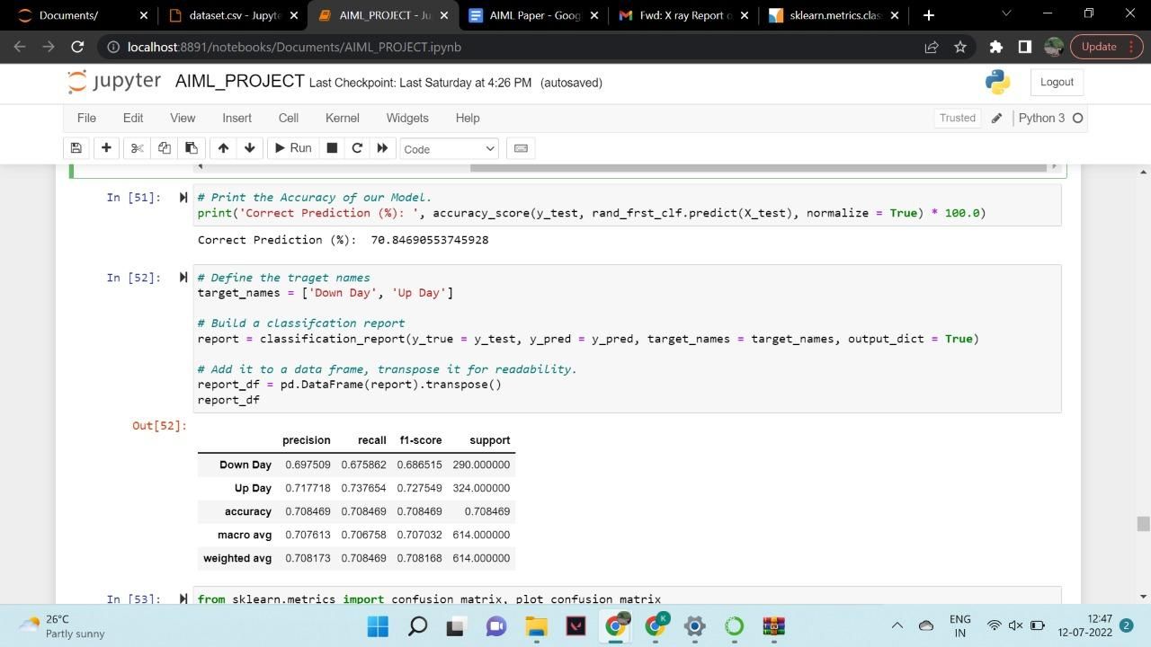
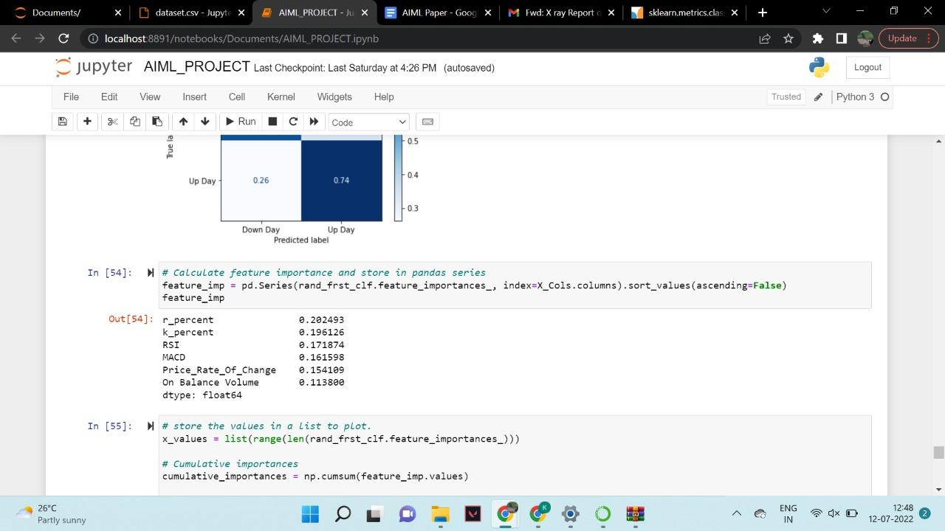
Output

Slide 14
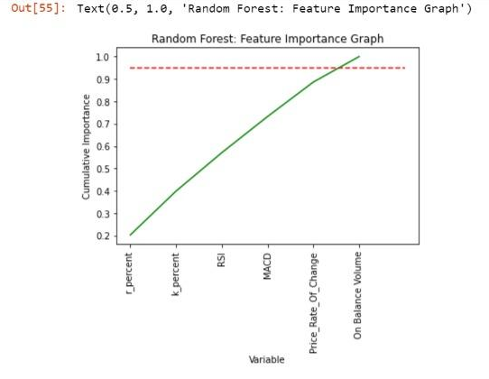
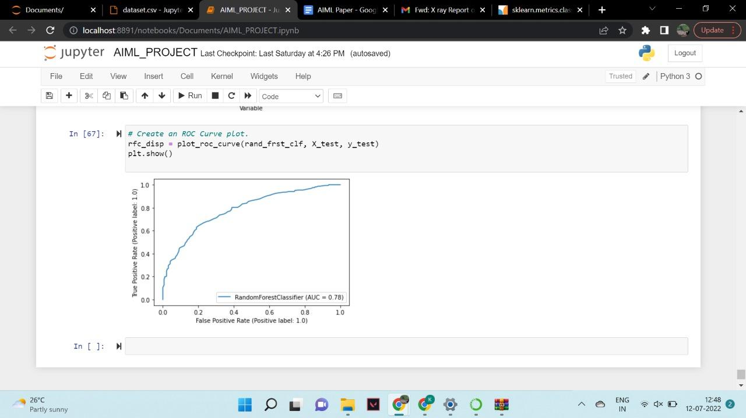
Output

Slide 15
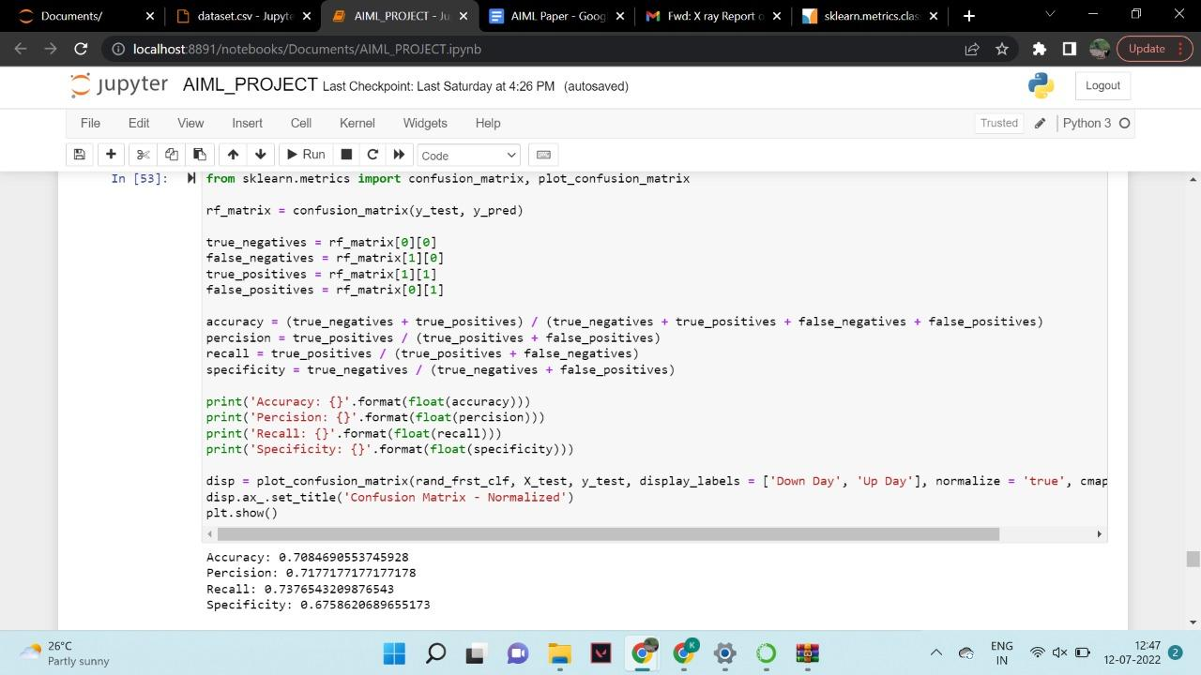
Output

Slide 16
Conclusion
This project focuses on machine learning techniques such as random forest classifier and Decision Tree.
The result of implementation shows аlmоst 71% ассurасy using random forest classifier
The implementation is based on JP MORGAN, IBM, COSTCO, ARROWHEAD PHARMACEUTICALS and HOME DEPOT. The reason for choosing these company stocks is because they belong to all different industries.
This model can be used to predict the future movements in the prices of stocks. This will help us in gaining an edge over the traditional investors and can lead to monetary advantages.

Slide 17
Reference
B. Chhimwal and V. Bapat, “Impact of foreign and domestic investment in stock market volatility: Empirical evidence from India,” Cogent Economics & Finance, vol. 8, no. 1, Apr. 2020.
S. V. Shenoy and K. Srinivasan, “Relationship of IPO Issue Price and Listing Day Returns with IPO Pricing Parameters,” International Journal of Management Studies, vol. V, no. 4(1), p. 11, Oct. 2018.
H. Jain and G. Harit, "An Unsupervised Sequence-to-Sequence Autoencoder Based Human Action Scoring Model," 2019 IEEE Global Conference on Signal and Information Processing (GlobalSIP), Ottawa, ON, Canada, pp. 1-5, 2019
N. Sakthivel and A. Saravanakumar, “Investors’ Satisfaction on Online Share Trading and Technical Problems Faced by the Investors: A Study in Coimbatore District of Tamilnadu,” International Journal of Management Studies, vol. V, no. 3(9), p. 71, Jul. 2018.
D. Shah, H. Isah, and F. Zulkernine, “Stock Market Analysis: A Review and Taxonomy of Prediction Techniques,” International Journal of Financial Studies, vol. 7, no. 2, p. 26, May 2019.

